Slide 1
Unit Testing - MyYear13

Slide 2


Unit Testing - MyYear13
Jest is a delightful JavaScript Testing Framework with a focus on simplicity. It works with projects using: Babel, Typescript, Node, React, Angular, Vue and more!
Vue Test Utils is the official unit testing utility library for Vue.js. Providing comprehensive API to assert Vue (data, props, computed properties, methods, emit, Vuex…)
+

Slide 3
Unit Testing - MyYear13
Unit Testing steps:
Create a test suite (a block of tests) describe(…)
Set up your test(s) test(…) or it(…)
Mount the component with vue-test-utils mount(…)
Set data, props…if necessary
Assert what the result should be expect(…)

Slide 4
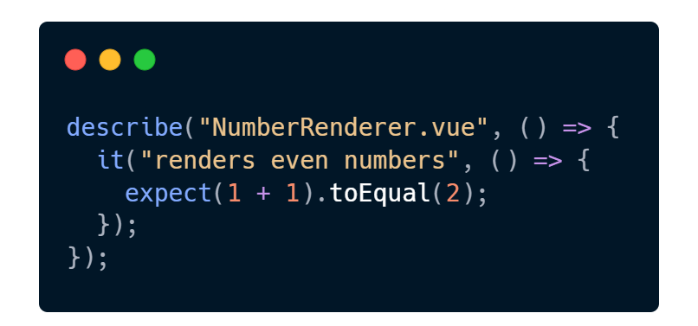

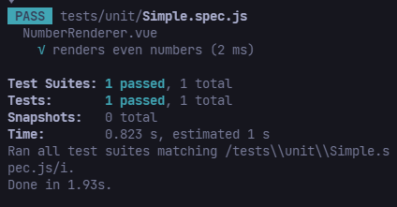
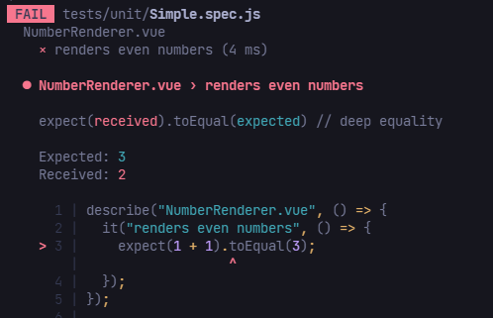


Test case - Result

Slide 5

What to test?
Outputs
Rendered Output (Data): what is rendered to the DOM
Events: component emits an event
Route Changes: when the route changes
Store: updates to the state
Connection with children: changes in child components
Inputs
Data: the component’s data
Props: the component’s props
User Interaction: user clicks a button
Lifecycle Methods: mounted(), created(), etc.
Store: state management data
Route Params: data in the route

Slide 6
Demo Flow
1. Set up a test case – Simple.spec.js
2. Rendering Components – Greeting.spec.js
3. Testing Props, Data – SubmitButton.spec.js
4. Computed Properties – NumberRenderer.spec.js
5. Simulating user input – FormSubmitter.spec.js
6. Testing emitted event – Emitter.spec.js
7. Mocking global objects – Bilingual.spec.js
8. Stubbing components - ParentWithAPICallChild.spec.js
9. Vuex – Try it your self
Repo: https://github.com/Dafreak99/Vue-TDD

Slide 7
What not to test?
Implementation Details:
We don’t need to care about the inner implementation of a method or a computed property
What only need to know the expected output for a specific input and write test case for to assert that
2. Testing the Framework Itself
A data, computed property, props got rendered to the template
3. Third party libraries
Vuex, VueRouter, Axios, and other NPM packages are out of testing scope

Slide 8
References
Vue Test Utils’ Doc: https://v1.test-utils.vuejs.org/guides
Vue Testing Handbook: https://lmiller1990.github.io/vue-testing-handbook/
Vue School: https://vueschool.io/courses/learn-how-to-test-vuejs-components
Knowing What To Test: https://vuejsdevelopers.com/2019/08/26/vue-what-to-unit-test-components/
Unit Testing in Vue: What to test? https://www.vuemastery.com/blog/unit-testing-vue-what-to-test/

Slide 9

Thank you!

